Slide 1

Last Call
Sam
Erin
Micheal
Ali
Alex

Slide 2
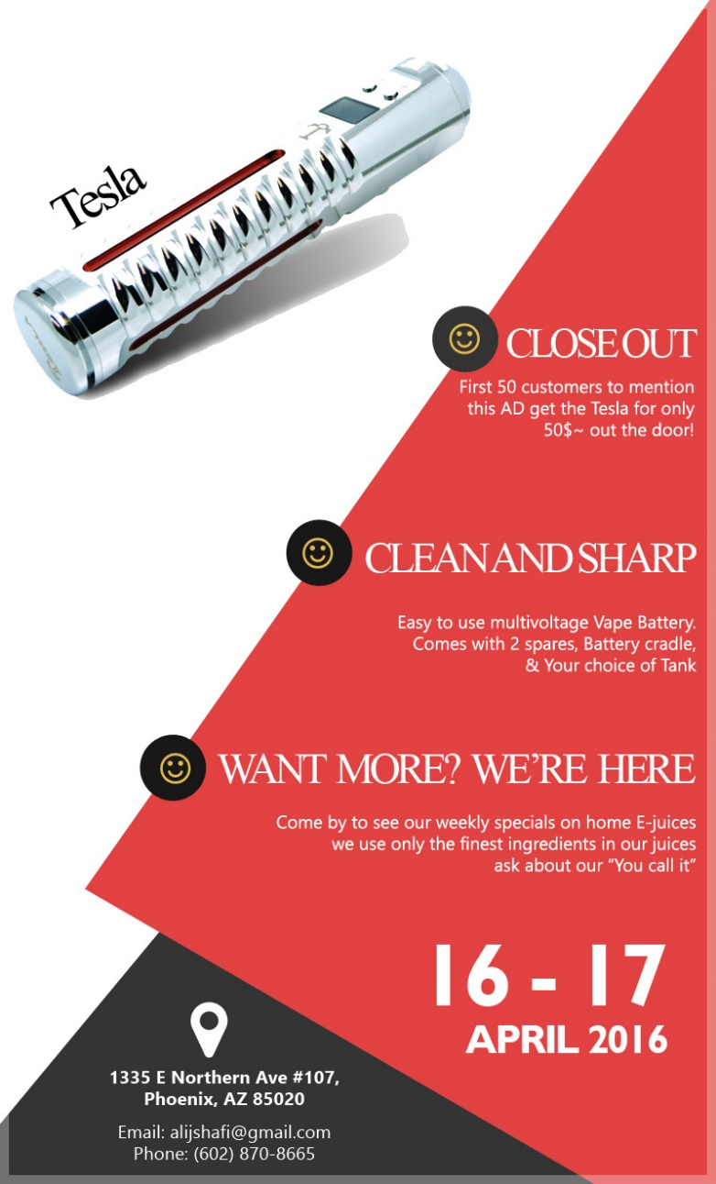
Test Advertisement
Limit the number of redemptions
Have a clear price
Limited time
Address

Slide 3
Results
Sent to 47
Redeemed 13
Not redeemed 34

Slide 4
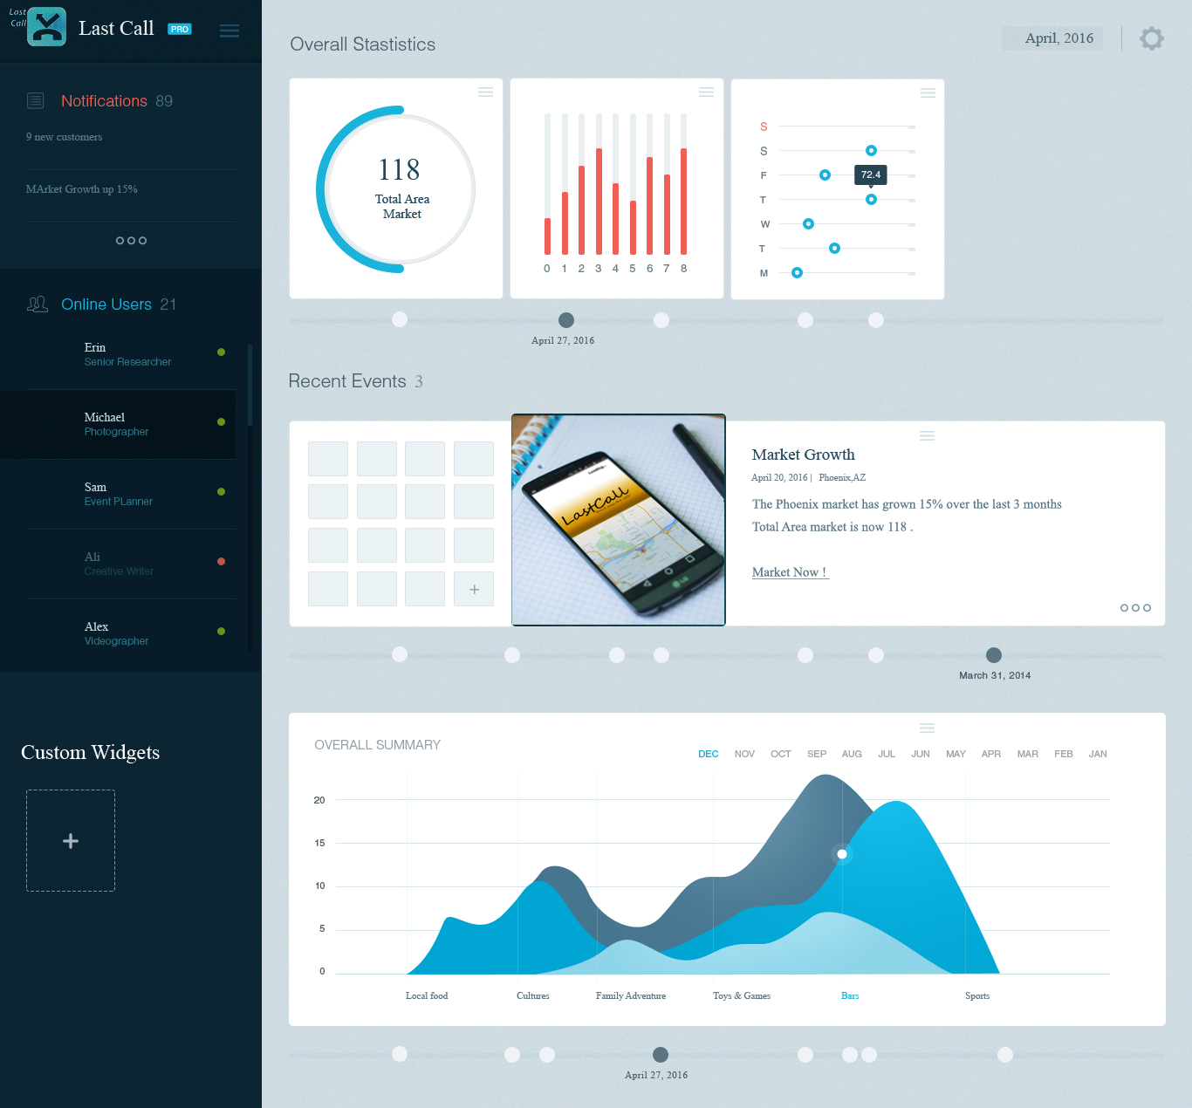

Slide 5
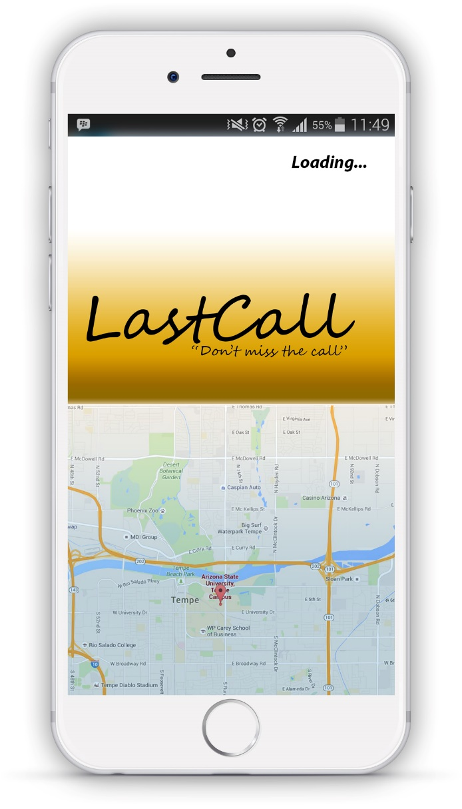
Questions ??

